Slide 1
Standards-Based Assessment & Reporting
ITAG Conference
2012
Notes:
Materials:
O’Connor book & Wormeli book
Laptop & dongle
Projector & screen
Speakers
Sticky notes
Notecards
Handouts
Chart paper and markers

Slide 2
Introductions
Jill Urich, Assistant Superintendent of Curriculum & Instruction
Amanda Koehler, Curriculum Coordinator
Julie Blevins, Instructional Coach
Renee Wulff, Social Studies Teacher
Notes:
Briefly share our backgrounds & experiences
We are partners in learning and leading

Slide 3
We value your feedback!
White Notecards:
What pushed your thinking today?
What is that “try one thing” you are going to do?
Pink Notecards:
What can we do to improve our presentation?
What should we keep doing?

Slide 4
Let’s take a peek inside a refrigerator…
Please privately write your grade (A, B, C, D, F) on a sticky note.

Slide 5
What’s the grade?
When you open the door, the smell of an onion overwhelms you and brings tears to your eyes.
Some shelves are wiped clean, while the top shelf has grape jelly stuck to the outer edge.
The side door where the gallon of milk is stored has dry milk flakes pushed against the corners.

Slide 6
…and there’s more…
When you open the dairy drawer to get a slice of cheese, you notice a container with something green growing.
Condiments are organized together on the second shelf from the top.
You quickly close the door to breathe in fresh air.
Notes:
Renee/Julie/Amanda will collect your sticky notes while you engage in the next activity.

Slide 7
Individual Reflection
What does a grade represent?
Notes:
Reflect to yourself
Then, discuss with elbow partners
Share out to the large group (record on chart paper)

Slide 8
Grading the Refrigerator
A =
B =
C =
D =
F =
Notes:
Sense of urgency!
Need common, systemic approach
If this were a student, he would have performed the same in all of our classes and yet earned different grade, depending on the teacher.
Traditional grading practices focus on teacher’s approach to grading, and best practices in grading focus on what the student has learned and is able to do.

Slide 9
What do we believe?
School A
School B
School C
School D
(DuFours / Professional Learning Communities)
Notes:
What do we believe?
What do we want for OUR kids?
Where do we want to work?
What school did you attend?

Slide 10
Schools A, B, & C
School A: Learning is based on a student’s ability.
School B: Learning takes place only if the student takes advantage of the opportunities to learn within the school.
School C: All students can learn something, and we will create a warm, pleasant environment for them to learn.
Or…..

Slide 11
School D
School D: All students can learn, and we will do whatever it takes to help students learn and achieve the agreed upon curriculum and standards.
School D embraces gifted and high level learners.
School D generates need for SBAR.
Notes:
Discussions around grading bring lots of passion to the table!
Let’s agree to “assume good intentions” and not negatively judge.

Slide 12
What do these terms mean?
SBAR: Standards-Based Assessment & Reporting
SBG: Standards-Based Grading
SBR: Standards-Based Reporting
SBGR: Standards-Based Grading & Reporting
Notes:
It all means the same thing.

Slide 13
Standards-Based Reporting is…
reporting a student’s performance & progress as measured against a standard, rather than being compared to peers.
providing every student to meet or exceed standards.
communicating an honest assessment of how a student is performing academically and behaviorally.
supportive of Iowa Core Characteristics of Effective Instruction, including a focus on assessment FOR learning
tightly aligned with differentiated learning experiences to meet the needs of ALL learners.
Notes:
- Standards specify what students should know, understand, and be able to do.

Slide 14
Example of a Reporting System
Exceeds: Student demonstrates above grade level understanding for the targeted skill or concept.
Secure: Student can apply the skill or concept correctly and independently.
Developing: Student shows some understanding. Reminders, hints, and suggestions are needed to promote understanding.
Beginning: Student shows little understanding of the concept or skill. Additional teacher support is needed.
Needs Continuous Teacher Support: Student does not show any understanding of the concept or skill. Full teacher support is needed.
Insufficient Data
Not Assessed: The standard was not assessed during the reporting term.

Slide 15
Standards-Based Practices: The First Steps
The need for standards-based reporting emerges once the standards-based practices are in place.
Notes:
- Jill’s dissertation: Implementation of Standards-Based Reporting
- Handout detailing themes that emerged
Focused on what teachers NEED to implement successfully
Mistake: Schools/districts that jump in when practices aren’t in place

Slide 16
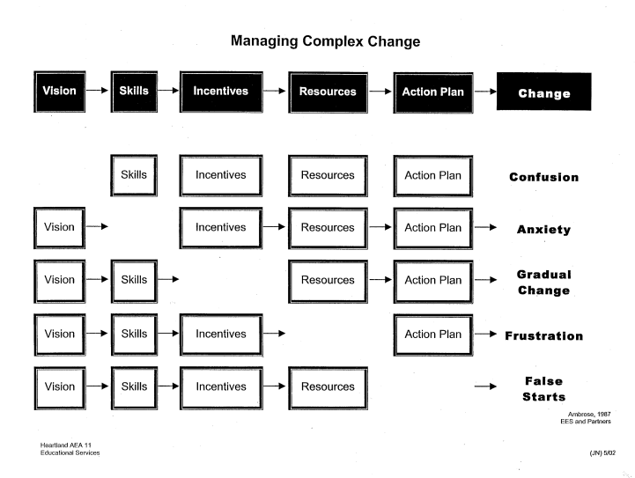
Notes:
“Try one thing”
Beliefs / Action / Results (Some people need beliefs, some people need action, some need results)

Slide 17
What’s our current reality in Ankeny?
Continuum of grading & assessment practices (some consistency, some variance)
Culture of continuous improvement
“Try one new thing”
Voluntary book study (Rick Wormeli’s Fair Isn’t Always Equal)
Building Leadership Teams’ book study (Ken O’Connor’s Grading for Learning, K-12)
Honoring readiness: Some PLCs reading O’Connor & engaging in grading conversations
District-wide committee (teachers, parents, students, admin)
Notes:
Embrace the messy!

Slide 18
What does the research from the experts say?
1. Separate behavior from academics in reporting of student performance.
Both need to be reported.
There is no research that supports using behavior to impact the academic grade in order to make a student more responsible.
Reporting separately provides accurate, specific feedback.
Accountability for both is important.
The BEST “punishment” for not doing your work is doing your work. (They “win” by accepting the zero.)
It’s about working SMARTER.
Adults AND students can respond appropriately.
Example: A “C” can mean many different things!

Slide 19
What does the research say?
2. Avoid penalizing students’ multiple attempts at mastery.
3. Avoid penalizing for late work.
Notes:
When we don’t allow retakes for 100%, the grade is not truly reflective of what the student has learned.
(Read excerpt from Wormeli – p. 114)
Greatest consequence is doing their work WHEN IT’S MEANINGFUL WORK (what if they already know the learning target? Then it’s just compliance)
Real life examples: Bar exam, driver’s license, admission to medical school
Examples here in Ankeny with staff responsibilities

Slide 20
What does the “Worm” say?
http://www.youtube.com/watch?v=FHeij2Zfil4&feature=related

Slide 21
What does the research say?
4. Avoid grading practice (homework).

Slide 22
What does the research say?
5. Avoid extra credit and bonus points.
Extra credit is usually not connected to the learning target.
We should expect students to do well on the assigned work that’s connected to the curriculum. It’s important because you assigned it.
Examples shared on twitter:
Don’t use bathroom pass for 9 weeks.
Bring box of kleenex.
5 points per cricket for science.
Buy the teacher a Snickers bar to move from F to D for final grade.

Slide 23
What does the research say?
6. Avoid group grades.

Slide 24
The “Worm” has more to say…
http://www.youtube.com/watch?v=nMJ-vEl4WB8&feature=related

Slide 25
What does the research say?
7. Avoid grading on a curve.
Don’t you want ALL students to do well?
Criterion-referenced vs. Norm-referenced
Parachute Concept: Who do you want to pack your parachute?
Notes:
It’s not a badge of honor to have students fail your class.

Slide 26
“Try one thing”
Hearing from our teachers in the trenches
Amanda
Julie
Renee

Slide 27
Our Contact Info
julie.blevins@ankenyschools.org / twitter @JulieBlevins1
amanda.koehler@ankenyschools.org / twitter @AmandaKoehler1
renee.wulff@ankenyschools.org / twitter @25rrwulff
jill.urich@ankenyschools.org / twitter @jillurich
Notes:
Questions?

Slide 28
Feedback Cards
Take the white card with you.
Leave the pink card with us.
Thank you for learning with us today!

